Slide 1
Australia
Frank, anneloes, kevin & rick

Slide 2
Today:
Assigment
History
Ancestry & Immigration
Population
National Symbols and Holidays

Slide 3
Assignment

Slide 4
History
Rick Groenbroek

Slide 5
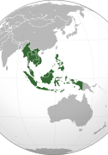
45,000 years ago
Aboriginals came from South-East Asia
Land bridges, canoes

Slide 6
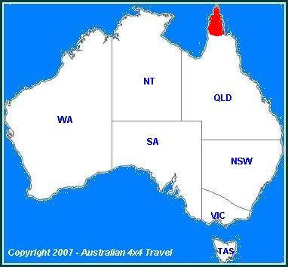
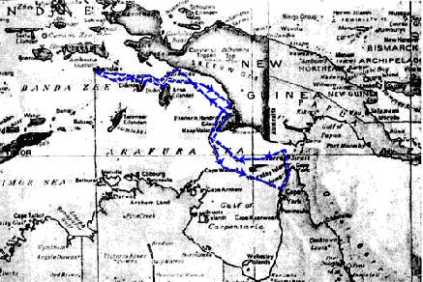
The Dutch - 1606
Willem Janszoon
VOC – New Guinea
Pennefather River

Slide 7
Abel Tasman
First Pacific Voyage
1642 Van Diemen’s land (Tasmania)
Antonio van Diemen, Governor-General Dutch East Indies
Second Pacific Voyage
1644 Mapped northern Australia
New Holland
Disappointment

Slide 8
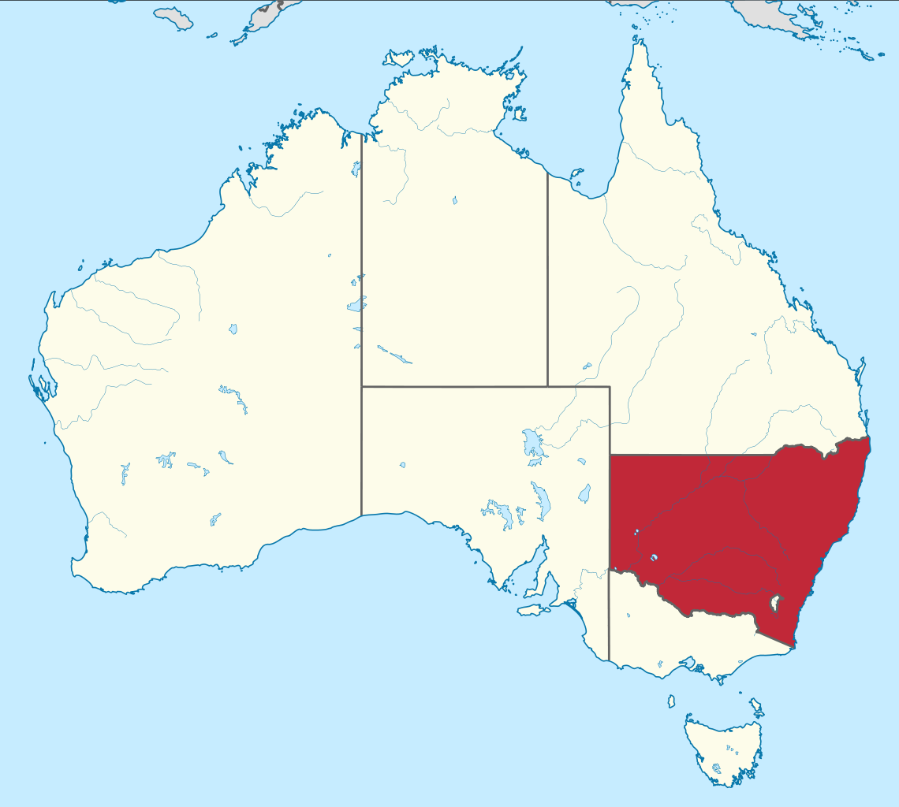
The British
James Cook
1770 – East Coast – New South Wales
1783 – Loss of American Colonies
First Fleet (Botany Bay – Sydney Cove)
11 vessels, thousand settlers, including 778 convicts
Between ‘88 and ‘92 4300 convicts
1791 beginning of trade
Penal Colony “Settlement used to exile prisoners and seperate them from the general populace in a remote location”

Slide 9
Ancestry and Immigration
Kevin Dijkema

Slide 10
Ancestry/immigration
Inleiding:
https://www.youtube.com/watch?v=HJHbbAQmpJQ
3.57 – eind

Slide 11
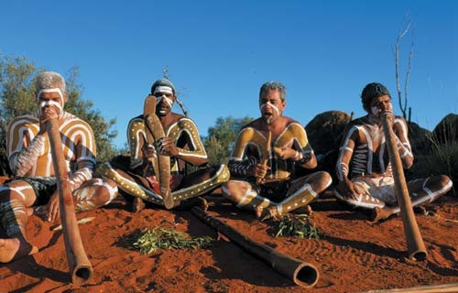
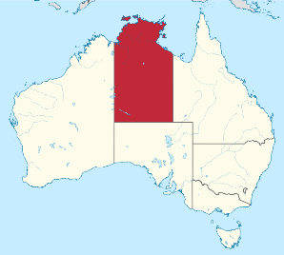
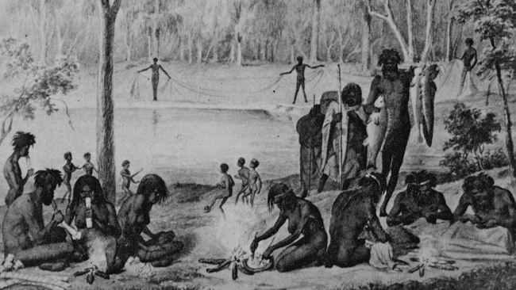
Aboriginal Australians
1788: British empire
Meaning of aborigine
Constitution of Australia (1901)
1962: Power to the Aboriginals
Population & territory
606.164 (2.7%)

Slide 12
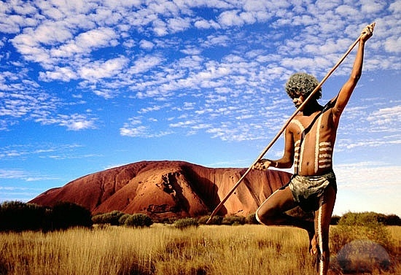
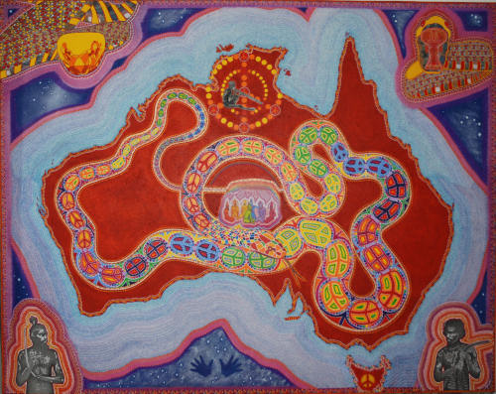
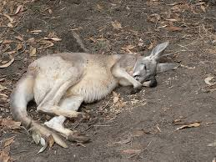
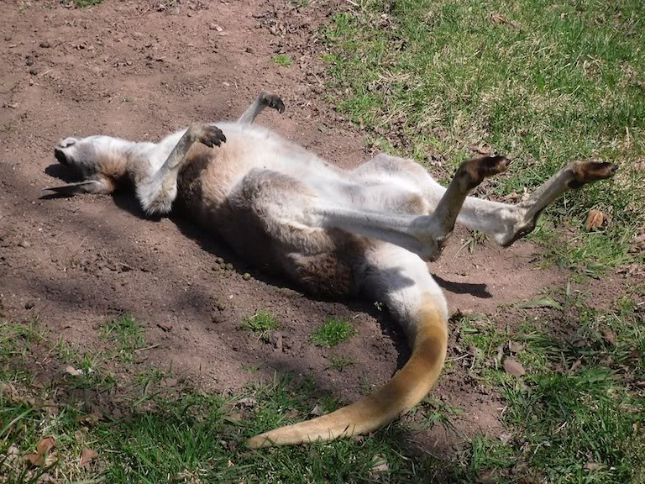
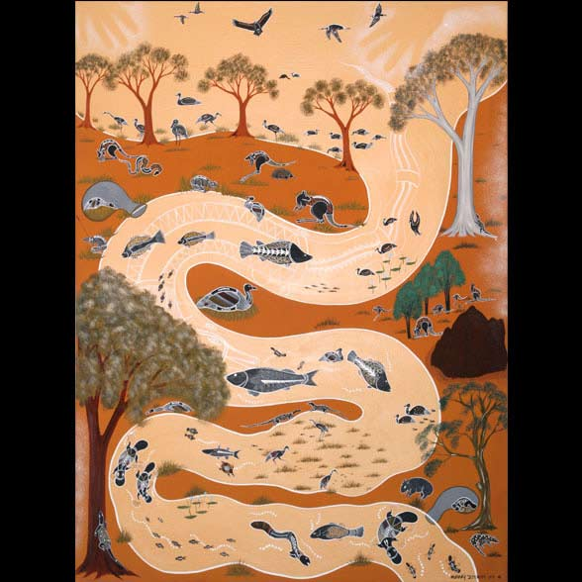
Dreamtime
‘Heaven’
Act of creation: dream vs. reality
Ancestors’ creations
Ancestors’ spirits
The Rainbow Serpent
‘Dreaming’
Dreamtime (environment)
Notes:
Uluru: sacred rock formation in the middle of Australia (battle of 2 ‘gods’) remainders of the battle = rock formation

Slide 13
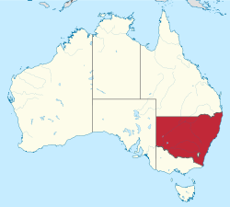
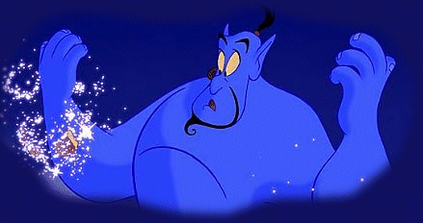
Botany bay
Dutch 1606
Claimed by the British in 1770
New South Wales: 1788
Port Jackson (Sydney harbour)
Convicts
Punishment
Free

Slide 14
Immigration (British, Irish, Asian, Italian)
Who When Why
British settlers and convicts 1788 – 1870 Colonising
Irish volunteers and convicts 1791 – 1867 Poor Irish economy
Asian labourers 1840s/1850s+ Work & gold rush
Italian musicians, artists,
business men ~1869 Non-economic reasons

Slide 15
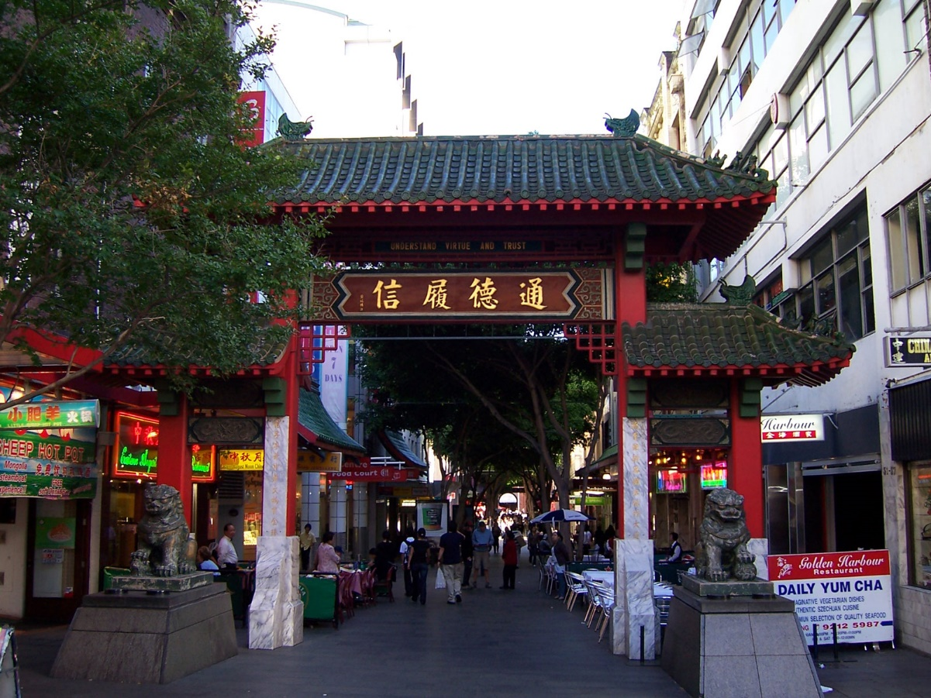
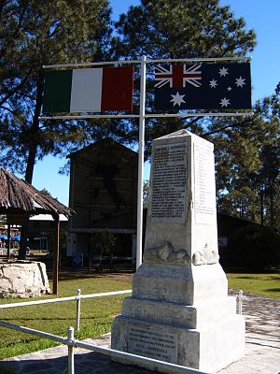
Results:

Slide 16
Population
Frank Uijtendaal

Slide 17
Population
Numbers/Urban areas
Density
Settlement

Slide 18
Numbers
23.622.645 People
Increase of 269 936
Current numbers
3rd least densely populated country

Slide 19
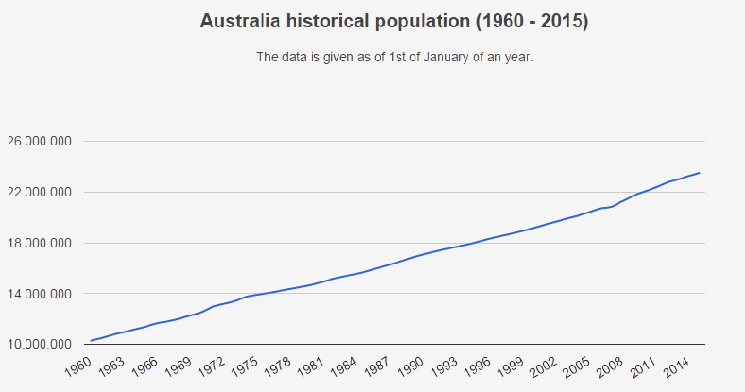
Numbers

Slide 20
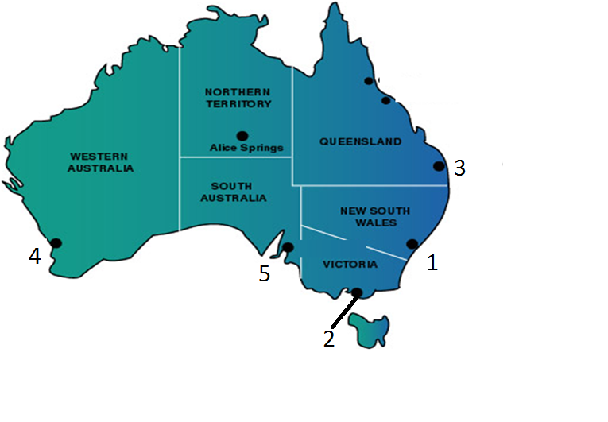
Numbers/Urban areas

Slide 21
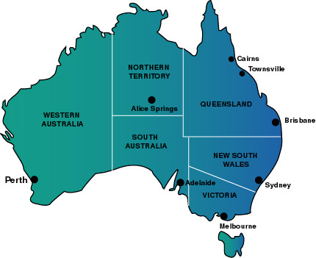
Numbers/Urban areas
Notes:
Cities of Australia
Sydney
Melbourne
Brisbane
Perth
Adelaide

Slide 22
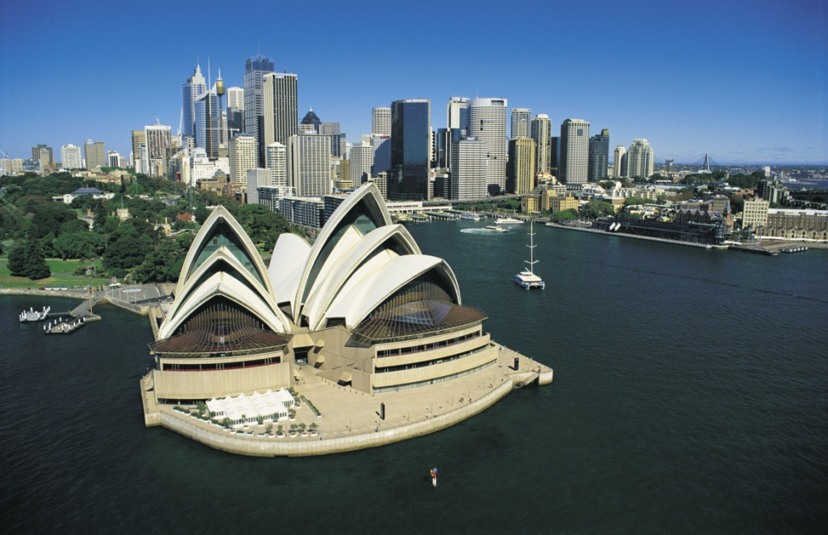
Numbers/Urban areas
Sydney
4,840,628
Sydney fish market
Opera house costs
1 in 8 people are
over 65 years old in Sydney.

Slide 23
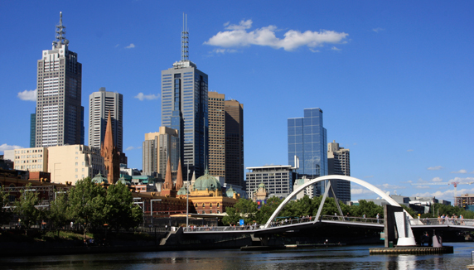
Numbers/Urban areas
Melbourne
4,440,328
Australia’s second biggest
City
Capital city for 26 years (1901 and 1927) (Canberra)

Slide 24
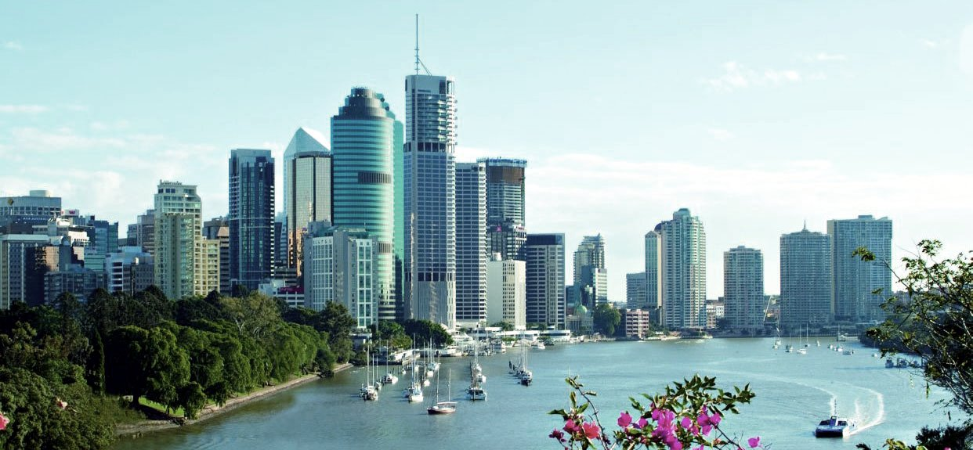
Numbers/Urban areas
Brisbane
2,274,460
Summer: December-February
Locals: Brisbanites
21.7% born in
a different
country

Slide 25
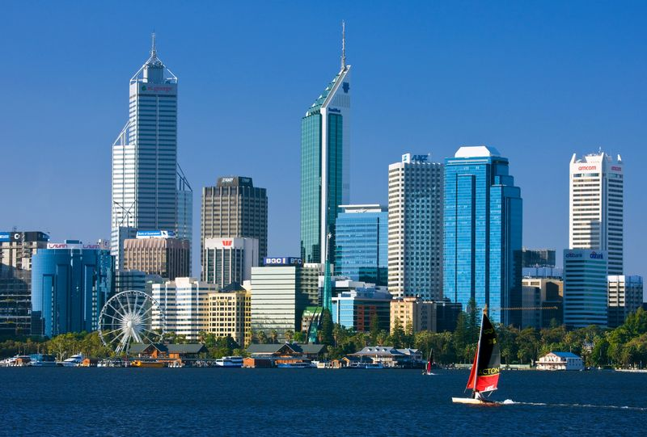
Numbers/Urban areas
Perth
2,021,203
Boorloo
Sunniest city
Biggest number of
millionaires

Slide 26
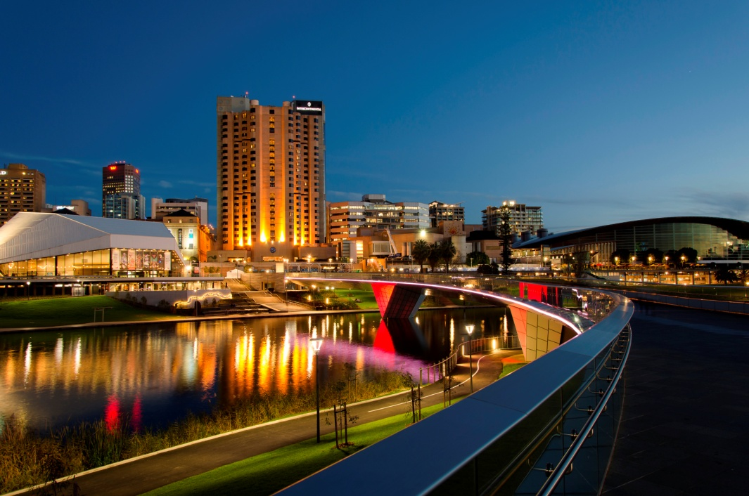
Numbers/Urban areas
Adelaide
1,304,631
20 minutes city
City of churches

Slide 27
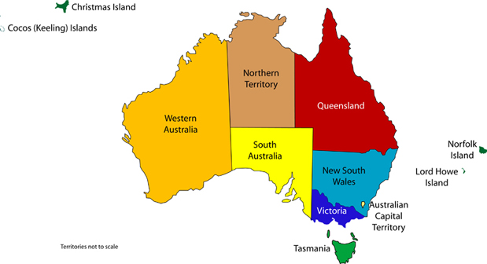
Density
‘’Coast huggers’’
WA: 2,589,100
SA: 1,688,700
QL: 4,740,900
NSW: 7,544,500
V: 5,866,300

Slide 28
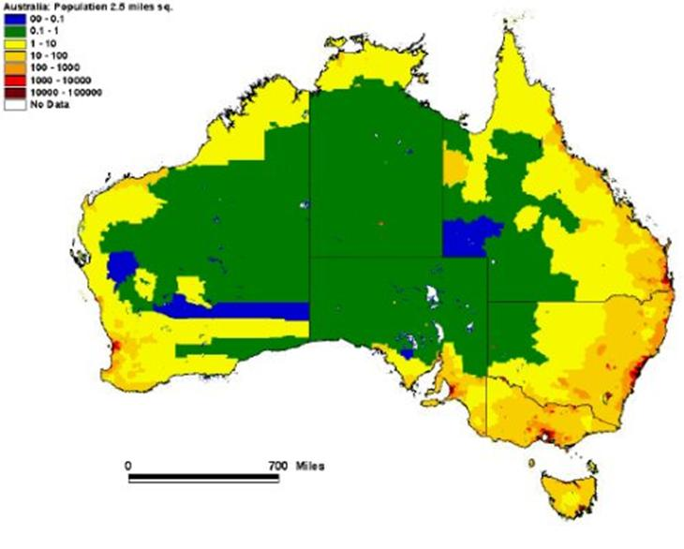
Density

Slide 29
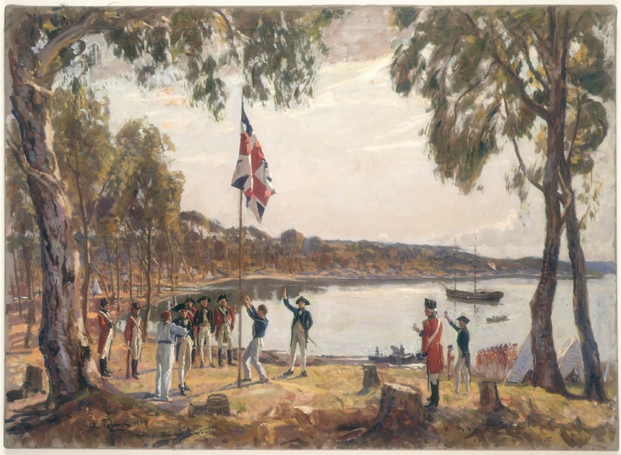
Settlement
First Europeans 1788
Aboriginal civilisation
Difficulties to settle
Conflict

Slide 30
National symbols and Holidays
Anneloes Nieuwenhout

Slide 31
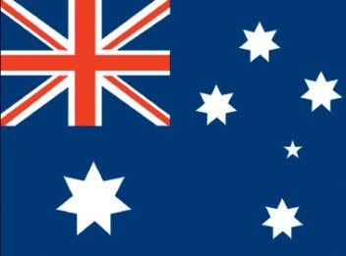
The Flag
Flag Act 1953
Union Jack
Loyalty to Britisch Empire
Commenwealth Star
7 pointed Star
Southern Cross
Constellation

Slide 32
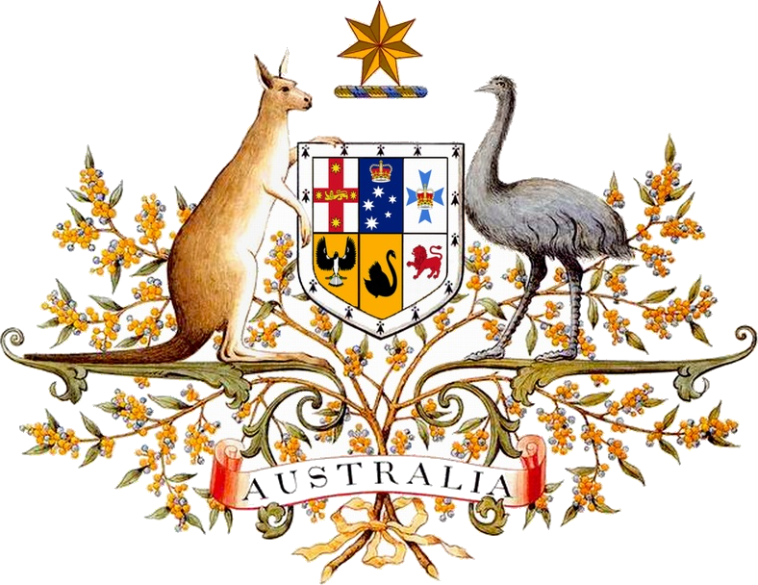
Coat of Arms
Commonwealth Star
Shield
Red Kangaroo
Emu
Golden Wattle

Slide 33
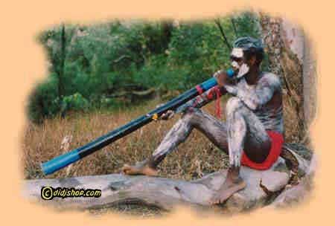
Didgeridoo
Wind instrument
Indigenous Australians
Northern Australians
1500 years old
Didgeridoo

Slide 34
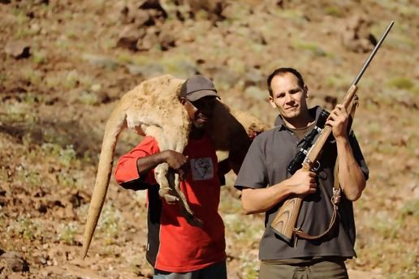
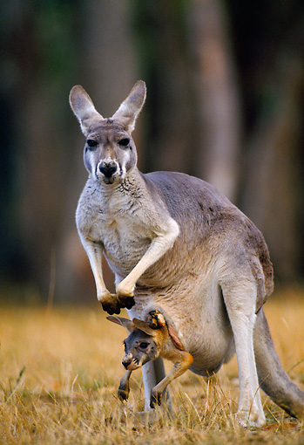
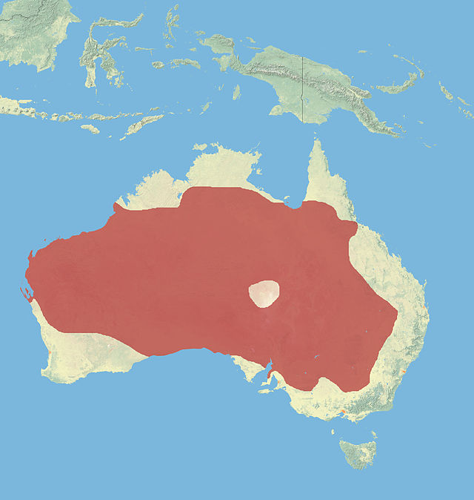
Red Kangaroo
Largest mammal
Males vs Females
Diet
Live in small groups
Joey
Commercial use

Slide 35
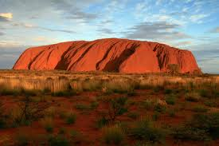
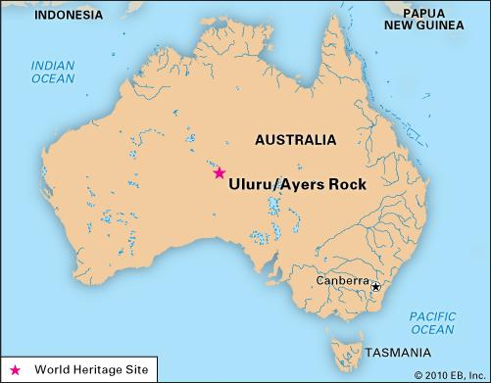
Uluru
Ayers Rock
Sacred to Anangu
Southern part of Northern Territory
Change colour
Arkose
Not climbing

Slide 36

Quiz
Fragment
Belongs to:
A: Koala
B: Kangaroo
C: Didgeridoo
D: Steve Irwin

Slide 37
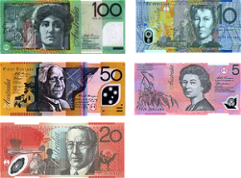
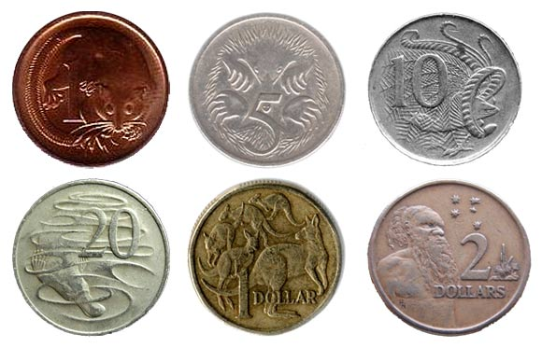
Currency : Australian dollar

Slide 38
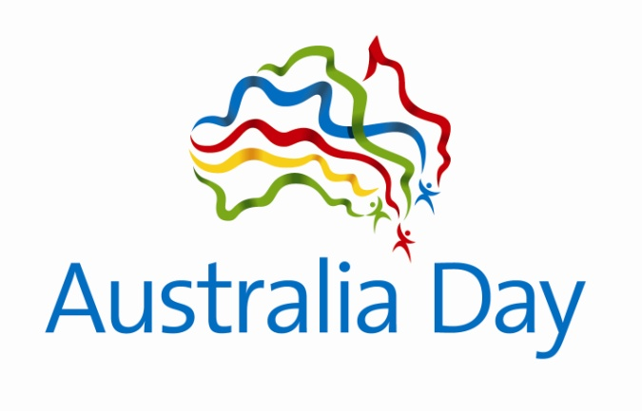
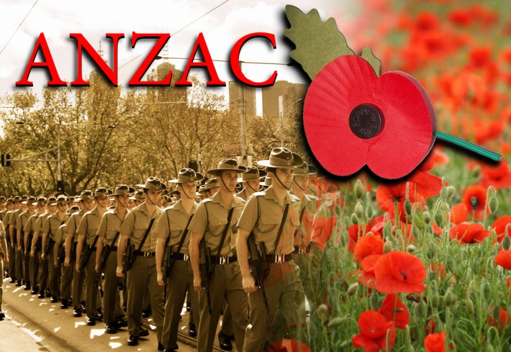
Holidays
Australia Day – 26th of January
Canberra Day – second Monday in March
Queen’s Birthday – second Monday in June
National Remembrance
Anzac Day – 25th of April

Slide 39
The end

